Slide 1
Tutorial: SEQ Simulator SNU CSE 4190.308 Lab #3

Slide 2
Configuration
Download Lab3.tar from eTL
arc@arc-pc:~> ls Lab3.tar
Lab3.tar
arc@arc-pc:~> tar xf Lab3.tar
arc@arc-pc:~> cd Lab3
arc@arc-pc:~/Lab3> ls
archlab.pdf sim.tar simguide.tar
arc@arc-pc:~/Lab3> tar xf sim.tar
arc@arc-pc:~/Lab3> cd sim
arc@arc-pc:~/Lab3/sim> make clean; make
…
../misc/yas prog7.ys
../misc/yas prog8.ys
../misc/yas prog9.ys
../misc/yas prog10.ys
../misc/yas ret-hazard.ys
make[1]: Leaving directory '~/Lab3/sim/y86-code‘
arc@arc-pc:~/Lab3/sim>

Slide 3
SEQ: Implement Sample Instruction
Sample instruction: LEAVE
As described in Section 3.7.2. in textbook.
It is equivalent to the following code sequence(X86-64):
1 movq %rbp, %rsp Set stack pointer to beginning of frame
2 popq %rbp Restore saved %rbp and set stack ptr to end of caller’s frame
It is equivalent to the following code sequence(Y86-64):
1 rrmovq %rbp, %rsp Set stack pointer to beginning of frame
2 popq %rbp Restore saved %rbp and set stack ptr to end of caller’s frame

Slide 4
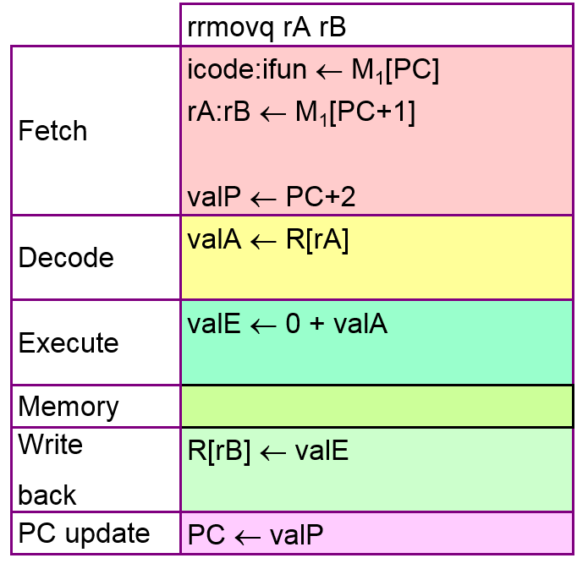
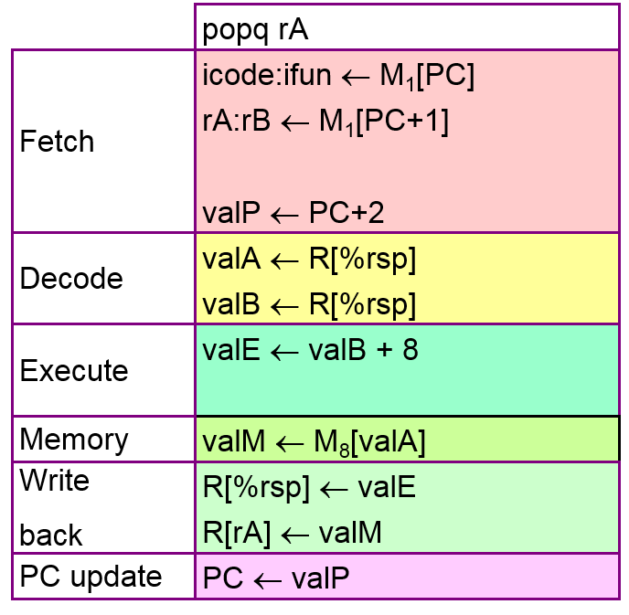
SEQ: Implement Sample Instruction
LEAVE = RRMOVQ + POPQ

Slide 5
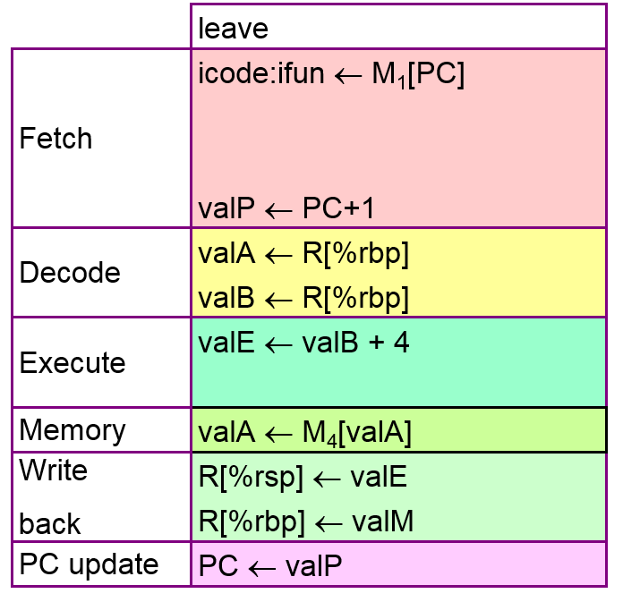
SEQ: Implement Sample Instruction
LEAVE = RRMOVQ + POPQ

Slide 6
SEQ: Implement Sample Instruction
Working directory: Lab3/sim/seq
Working file: seq-full.hcl
All your implementation should be in seq-full.hcl
arc@arc-pc:~/Lab3/sim> cd seq
arc@arc-pc:~/Lab3/sim/seq> vi seq-full.hcl

Slide 7

SEQ: Implement Sample Instruction
FETCH Stage

Slide 8
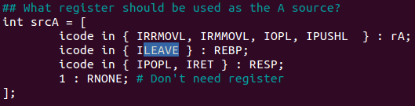
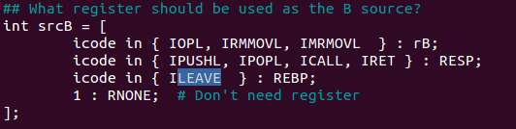
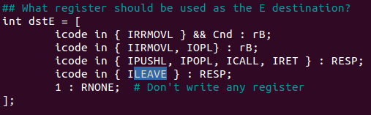
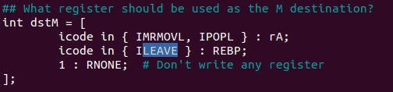
SEQ: Implement Sample Instruction
DECODE and WRITE BACK Stage

Slide 9
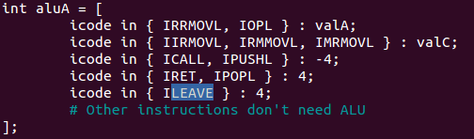
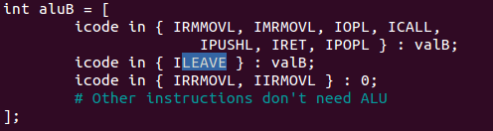

SEQ: Implement Sample Instruction
EXECUTE Stage

Slide 10
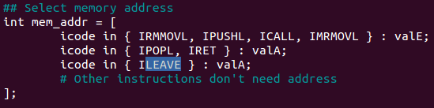
SEQ: Implement Sample Instruction
MEMORY Stage

Slide 11
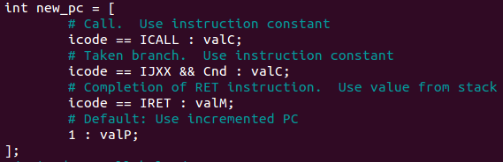
SEQ: Implement Sample Instruction
PC UPDATE Stage

Slide 12
SEQ: Implement Sample Instruction
Verification
Note: testLeave.yo is NOT in your Lab3 directory. It is ONLY for tutorial.
arc@arc-pc:~/Lab3/sim/seq> make VERSION=full
# Building the seq-full.hcl version of SEQ
../misc/hcl2c -n seq-full.hcl <seq-full.hcl >seq-full.c
gcc -Wall -O2 -isystem /usr/include/tcl8.5 -I../misc -o ssim \
seq-full.c ssim.c ../misc/isa.c -L/usr/lib -ltk -ltcl –lm
arc@arc-pc:~/Lab3/sim/seq> ./ssim –t testLeave.yo
…
Changed Memory State:
0x01f0: 0x0000000000000000 0x0000000000000055
0x01f8: 0x0000000000000000 0x0000000000000013
ISA Check Succeeds
arc@arc-pc:~/Lab3/sim/seq>
arc@arc-pc:~/Lab3/sim/seq> make VERSION=full
# Building the seq-full.hcl version of SEQ
../misc/hcl2c -n seq-full.hcl <seq-full.hcl >seq-full.c
gcc -Wall -O2 -isystem /usr/include/tcl8.5 -I../misc -o ssim \
seq-full.c ssim.c ../misc/isa.c -L/usr/lib -ltk -ltcl –lm
arc@arc-pc:~/Lab3/sim/seq> ./ssim –t testLeave.yo
…
%rdi: 0x0000000000000038 0x0000000000000018
%r10: 0x0000a000a000a000 0x0000000d000d000d
ISA Cond. Codes (Z=1 S=0 O=0) != Pipeline Cond. Codes (Z=0 S=0 O=0)
ISA Check Fails
arc@arc-pc:~/Lab3/sim/seq>

Slide 13
Thank you

